Slide 1
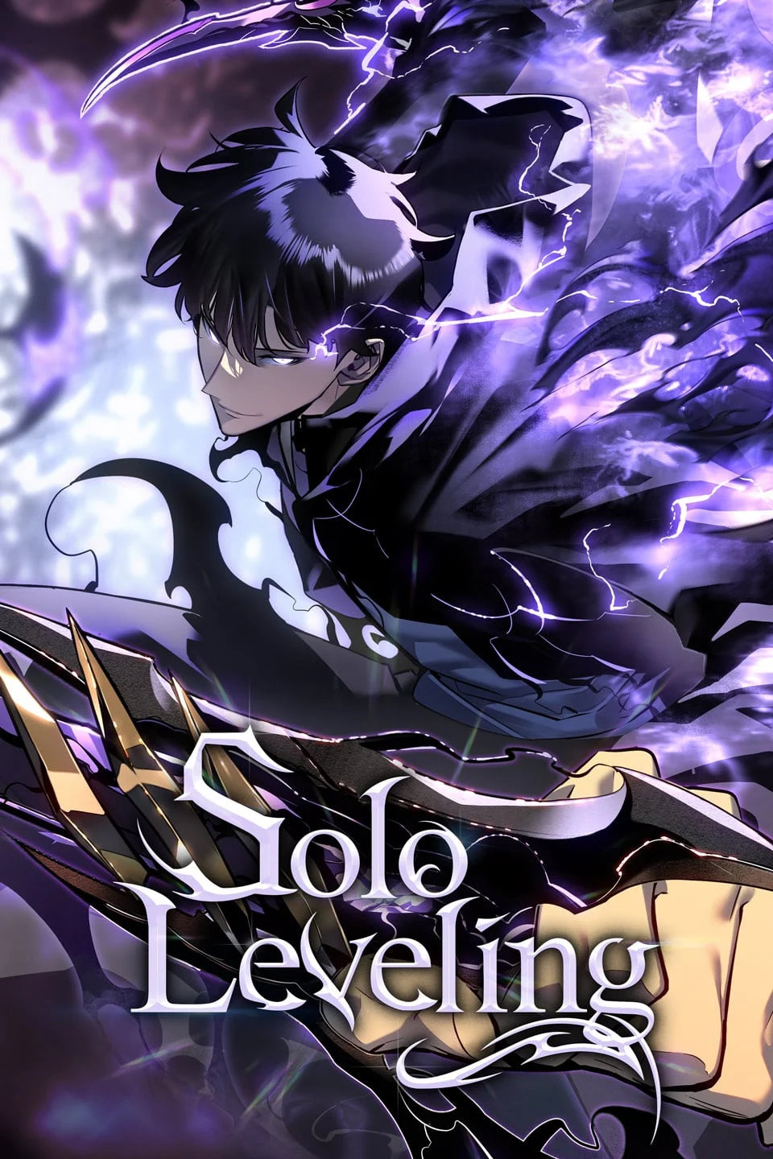

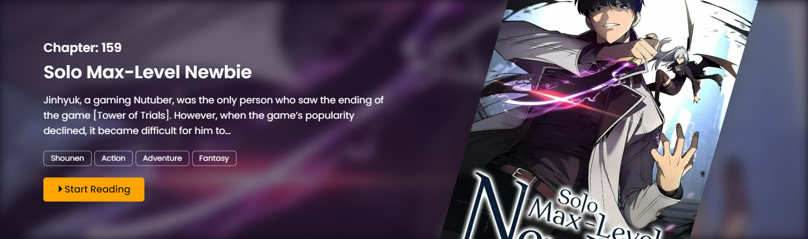

Slide 2
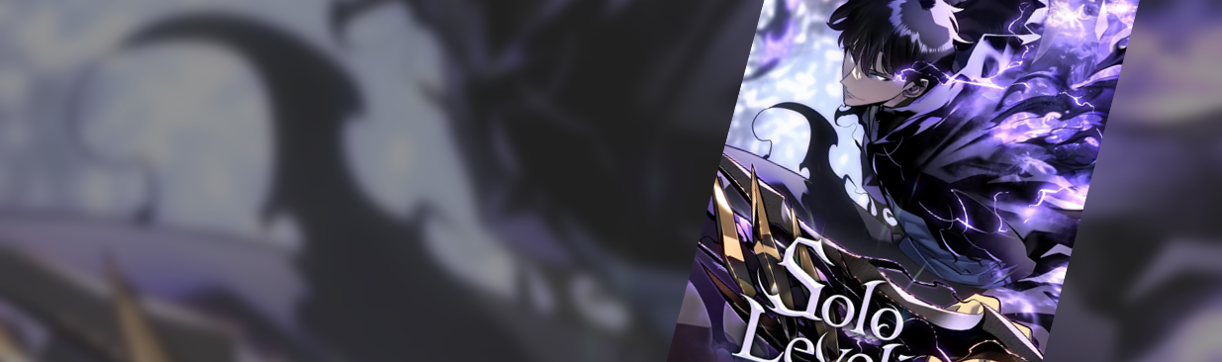

Chapter: 56
The Regressed Son of a Duke is an Assassin
In a desperate battle for his life against assassins led by Boris Rehelim, Cyan is fatally wounded and faces betrayal from Aschel himself. As he succumbs to death…
Fantasy
Seinen
Action
Drama

Slide 3
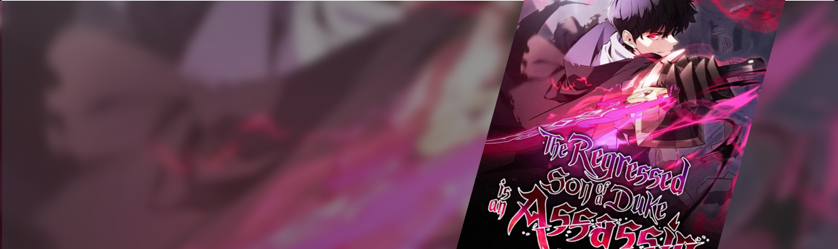
Chapter: 56
The Regressed Son of a Duke is an Assassin
In a desperate battle for his life against assassins led by Boris Rehelim, Cyan is fatally wounded and faces betrayal from Aschel himself. As he succumbs to death…
Fantasy
Seinen
Action
Drama
Chapter: 200
Solo Leveling
In a desperate battle for his life against assassins led by Boris Rehelim, Cyan is fatally wounded and faces betrayal from Aschel himself. As he succumbs to death…
Fantasy
Seinen
Action
Drama

Slide 4
Chapter: 56
The Regressed Son of a Duke is an Assassin
In a desperate battle for his life against assassins led by Boris Rehelim, Cyan is fatally wounded and faces betrayal from Aschel himself. As he succumbs to death…
Fantasy
Seinen
Action
Drama
Chapter: 200
Solo Leveling
In a desperate battle for his life against assassins led by Boris Rehelim, Cyan is fatally wounded and faces betrayal from Aschel himself. As he succumbs to death…
Fantasy
Seinen
Action
Drama

